Slide 1
E-WASTE
E-Waste is a popular , informal name for electronics products nearing the end of their useful life
Many of these products can be reused , refurbished or recycled.

Slide 2
INTRODUCTION
Electronic Waste one of the fastest growing waste streams all over the world.
Need for effective management
Up to 75% of electronics shipped to computer village in Lagos are irreparable junk.
Average 1-3% of total solid waste in developed countries.

Slide 3
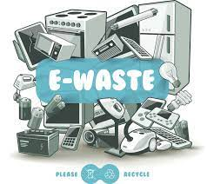

Slide 4
CONCLUSION
Just as human waste can pollute our oceans and air , e-waste can take over landfills , pollute developing nations and leach toxic chemicals into the earth.
E-waste can be recycled and reused . This type of waste can be reduced if taken proper care of.

